Slide 1
An Introduction to the Larger Context
Linkages between carbon and climate change
Linkages between forests and carbon
Impacts of climate change on forests
The role of forests in climate mitigation and adaptation
Introduce the basic elements of the forest carbon cycle

Slide 2
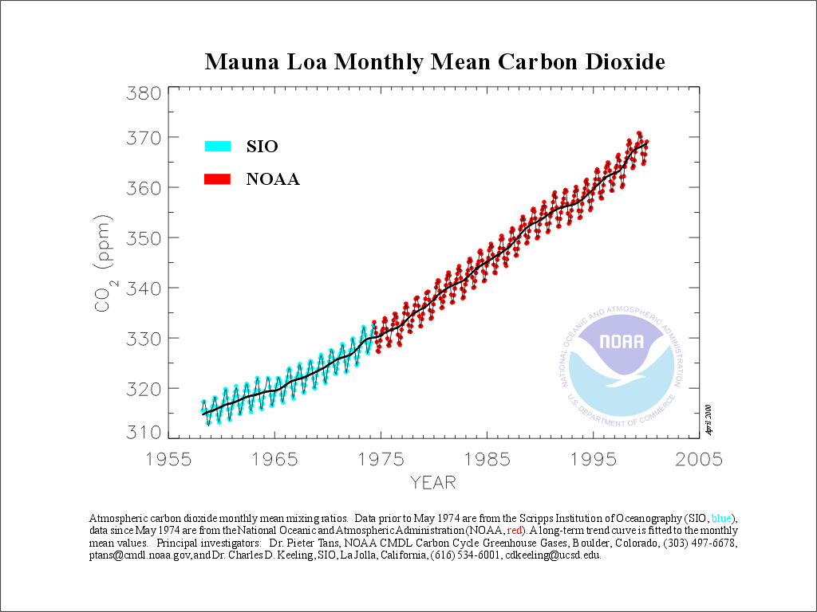
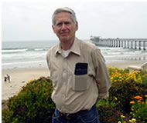
Global Warming: Where it all started
Dave Keeling
(1928-2005)
Atmospheric CO₂ is on the rise
attributable to fossil fuel emissions

Slide 3
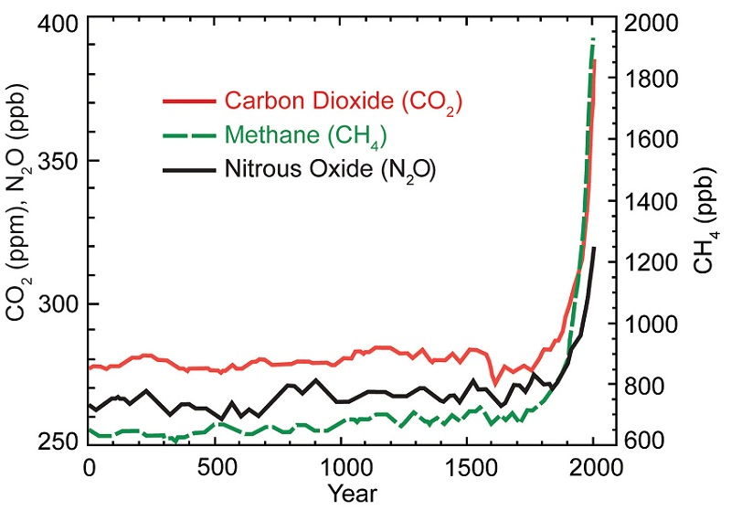
Dramatic Departure From Norm

Slide 4
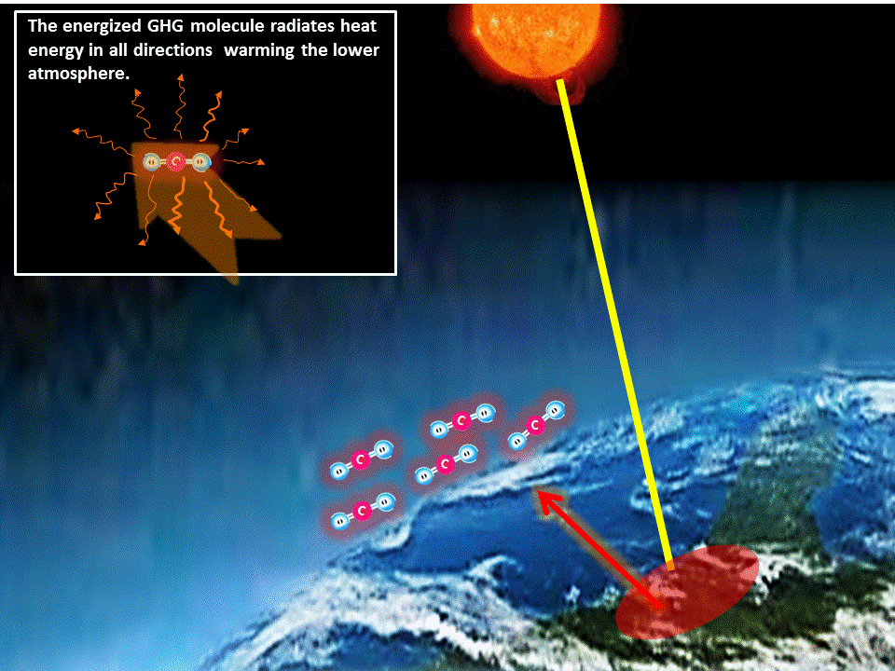
CO2 concentrations couples to temperature through radiative forcing

Slide 5
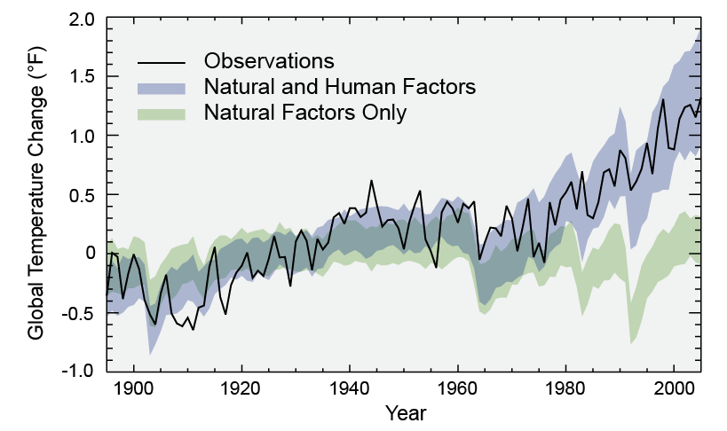
Separating Human and Natural Influences on Climate

Slide 6
Observed consequences
of Global Warming
Global average surface temperatures increased by 0.6 +/- 0.2 degrees Celsius over the 20th century (IPCC 2001)
Concurrent increase in atmospheric CO₂ (~282 to 366 ppm; 31% since 1750)
Global average sea-level has risen (0.1 – 0.2 m 20th century) and ocean heat content has increased
Snow cover and ice extent has decreased
lengthening of mid-to high-latitude growing seasons
poleward and altitudinal shifts of plant and animal ranges
earlier tree flowering, insect emergence and egg-laying in birds

Slide 7
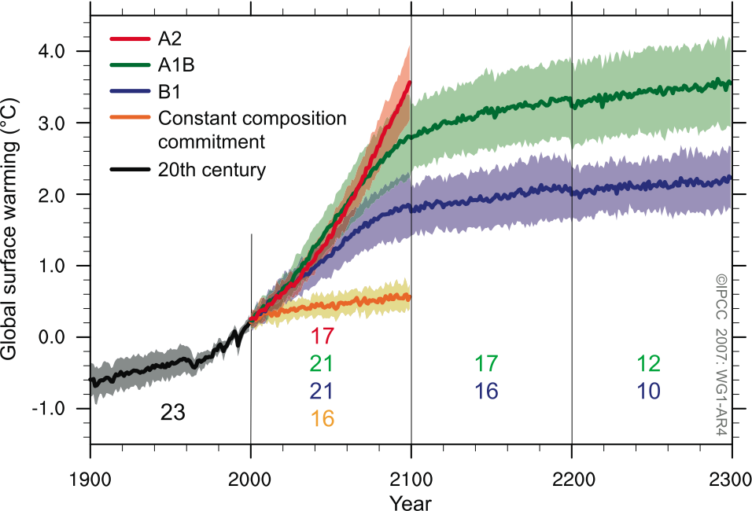
Model predictions of Future Warming

Slide 8
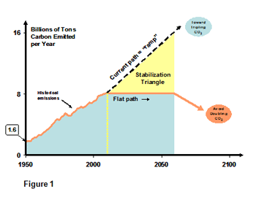
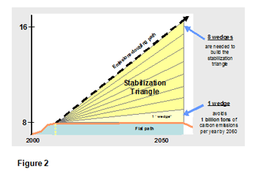
Stabilization “Triangle” and Stabilization “wedges”
Wedges include: Energy Conservation, Alternate fuels, Sequestration, Alternate land-use practices.
Forest Practices are important in part because they pertain to multiple wedges but largely because they play such an important role in the global carbon cycle as a whole

Slide 9
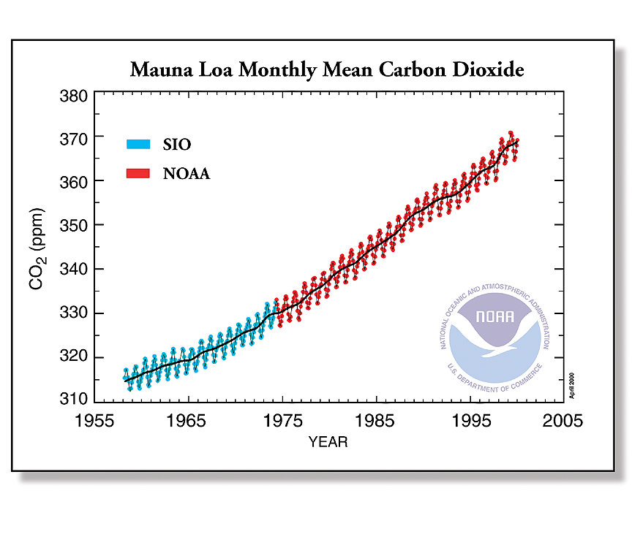
Forest Effects on Global CO2 strong enough
to be seen in the Signal

Slide 10
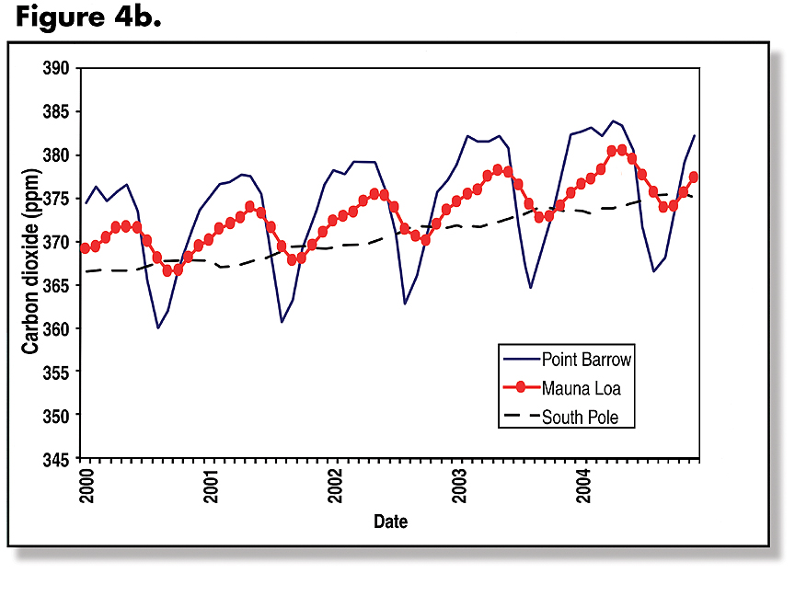
Forest Effects on Global CO2 strong enough
to be seen in the Signal

Slide 11
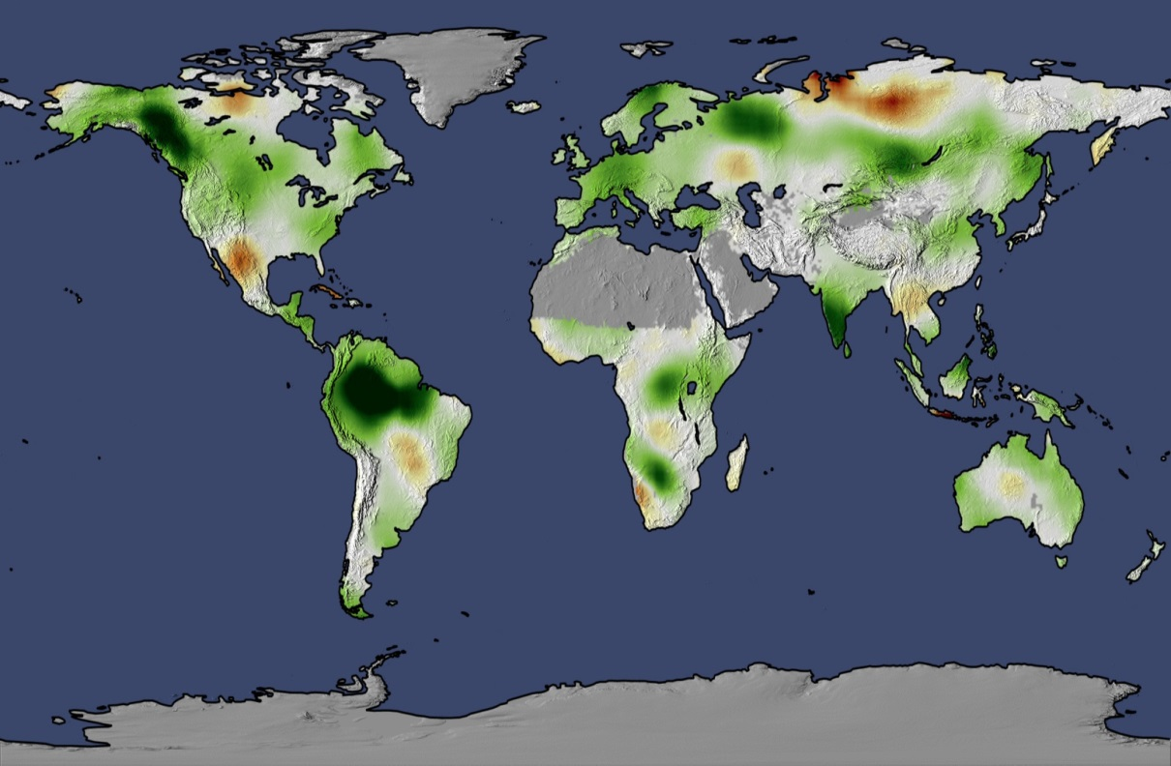
Forest Effects on Global CO2 strong enough
to be seen in the Signal
Map of forest productivity

Slide 12
Global Distribution of Carbon
1000 Pg
Marine Biomass
Top Ocean
Atmosphere
Deep Ocean
Forests
Other Biomass
Soil
Fossil Fuel

Slide 13
Global Distribution of Carbon
1000 Pg
Marine Biomass
Top Ocean
Atmosphere
Deep Ocean
Forests
Other Biomass
Soil
Fossil Fuel

Slide 14
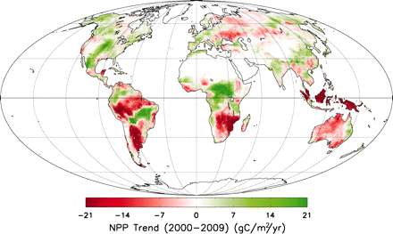
Effects of Climate change on forests:
Direct impacts on production
http://www.sciencemag.org/content/329/5994/940/F2.expansion.html

Slide 15
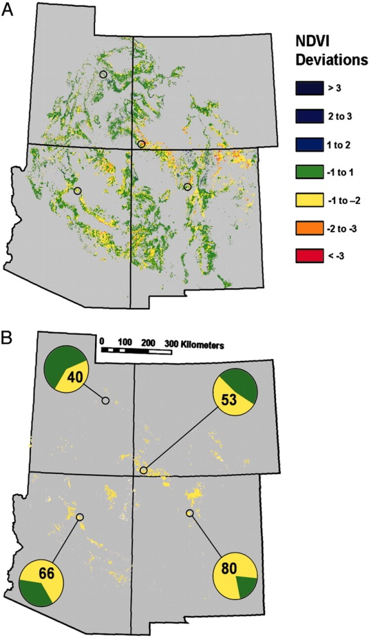
Effects of Climate change on forests:
Demographic impacts through tree mortality
Drought-induced canopy mortality (Breshears et al, 2005, PNAS)
Trends in tree mortality across the Western US (VanMantgem et al, 2009, Science)

Slide 16
Effects of Climate change on forests:
Shifting disturbance regimes
Lengthening Fire Season leads to more fire occurrence (Westering et al, 2006, Science)

Slide 17
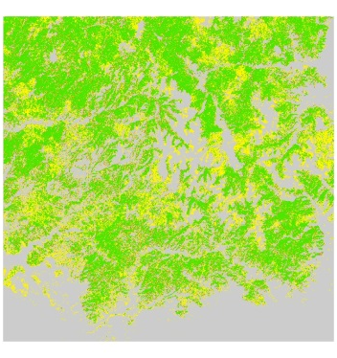
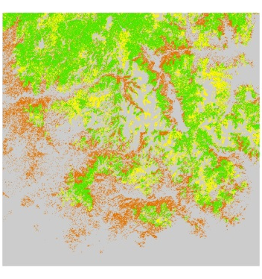
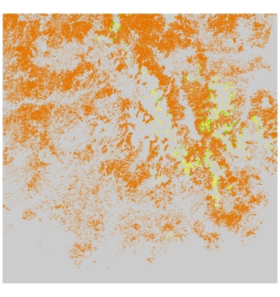
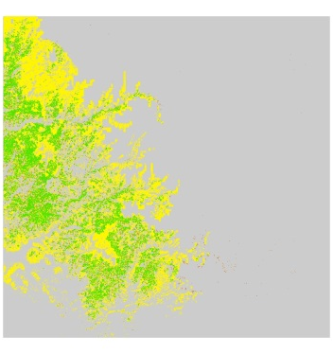
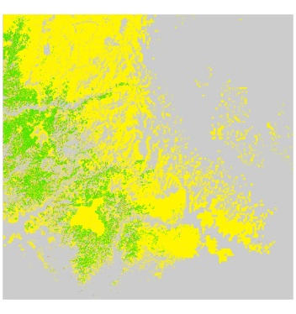
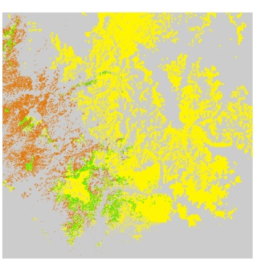
Effects of Climate change on forests:
Forest Distribution Shifts
2000
2060
2090
Douglas-fir
Occupied habitat
Unexploited habitat
Persistence outside habitat
Dramatic range shifts predicted in mountain regions, outpacing tree migration capacity (Campbell, in prep)
ponderosa pine

Slide 18
Management responses to Climate Change
Adaptation: actions taken to reduce the ultimate impact of climate-related change
Mitigation: actions taken to reduce the amount of carbon in the atmosphere or to reduce its input to the atmosphere

Slide 19
Adaptation Options
Resistance: forestall impacts and protect highly valued resources
Resilience: improve the capacity of ecosystems to return to desired conditions after disturbance
Response: facilitate transition of ecosystems from current to new conditions

Slide 20
Mitigation Options
Store more in forest ecosystems
  Longer rotations, less intensive harvest
  Increase productivity
Store more in forest products
  Harvest more frequently and intensively
  Build longer lasting structures
  Substitute more
Reduce emissions from disturbance
  Remove carbon
  Increase resistance and resilience

Slide 21
Understanding mitigation options begins with an understanding of the forest carbon dynamics
Atmosphere
Photosynthesis
Plant
Respiration
Decay
Forests and Forest Products
Combustion

